Slide 1

3666 ANLP
Predicting ECB Monetary Policy
Jonathan Fu
Fernando Espinosa
Shabnam Balamchi
Dec 16th/2023

Slide 2
Outline
Project Overview
Process Flow
Challenges encountered
Feedback and questions from the team
Next steps
Confidential draft, for discussion purposes only

Slide 3

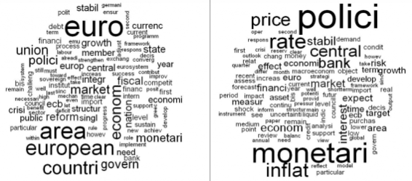
Project Overview: ECB Speech Analysis for Rate Change Prediction
Objective:
Predict ECB rate changes ("No Change," "Increase," or "Decrease") using speech text analysis.
Scope:
Data Analysis: Extraction and analysis of ECB speeches and press releases for predictive modeling.
Model Development: Building and fine-tuning a BERT-based classification model for forecasting ECB rate changes.

Slide 4
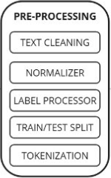


Process Flow
Title: Methodology Overview for ECB Rate Change Prediction
ECB Rate Changes Model
Speech Data
Rate Change Data
Weblink Data
No Change
Increase
Decrease
Fine-tuned BERT Model

Slide 5
Pre-Processing
Preprocessing Steps:
Text normalization & cleaning
Label Processing
Train/Eval/Test Split
Tokenization
Next step: ?

Slide 6

Dataset Overview
Speech Volume Over Time: Distribution of ECB speeches by year or event.
Key Themes: Word clouds or bar charts of most frequent terms.
Sentiment Analysis: Trends in sentiment scores over time.
Policy Correlation: Preliminary patterns between speech themes and policy changes
ECB Speech Dataset Overview
Total speeches: 3,434
Date range: 1999–2023
Language: Majority in English
Columns:
Speaker details (e.g., who, date, speech title).
Extracted text and term frequencies.
Monetary policy rate changes (% changes, direction).
Key Question:
"How does speech content correlate with monetary policy decisions?“

Slide 7
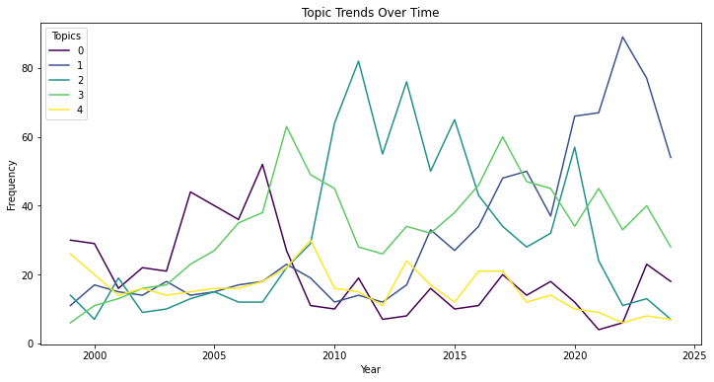
Temporal Trends in Topics
Digital euro and fiscal policy discussions have risen sharply since 2015.
Inflation and monetary policy remain consistently discussed across years.
This demonstrates how the ECB adapts its messaging to evolving economic conditions.
Topic 0 (financial growth and markets) saw a rise around 2010 but declined in prominence after 2015.
Topic 3 (economic and fiscal policy) peaked during the late 2000s, possibly reflecting responses to the 2008 financial crisis.
Topic 4 (central banking and risk management) had a steady focus, indicating its importance across different timeframes.

Slide 8
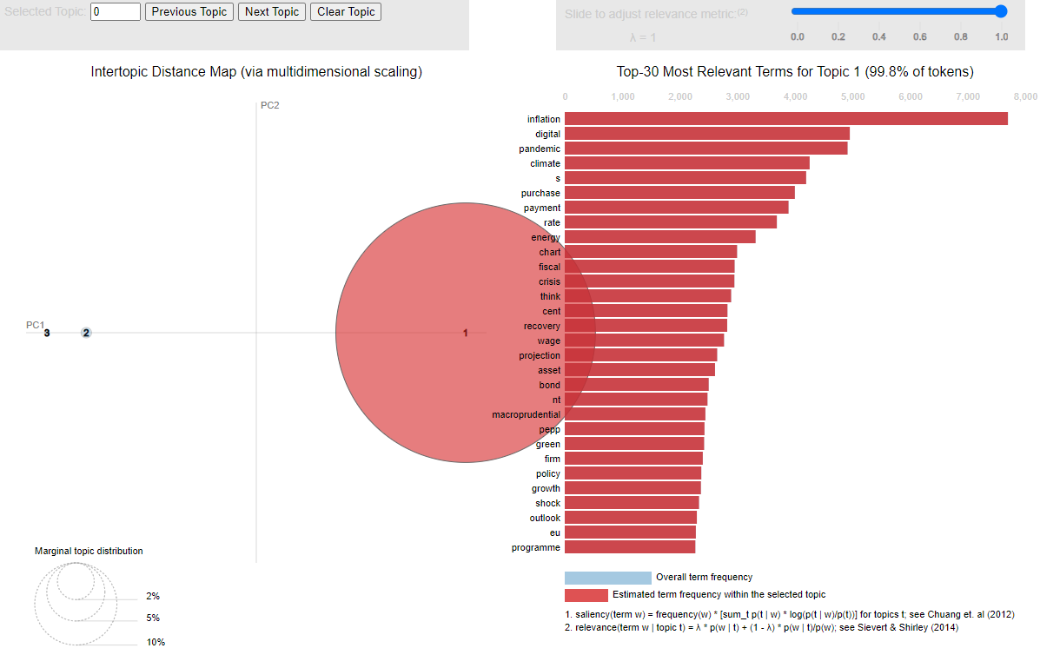
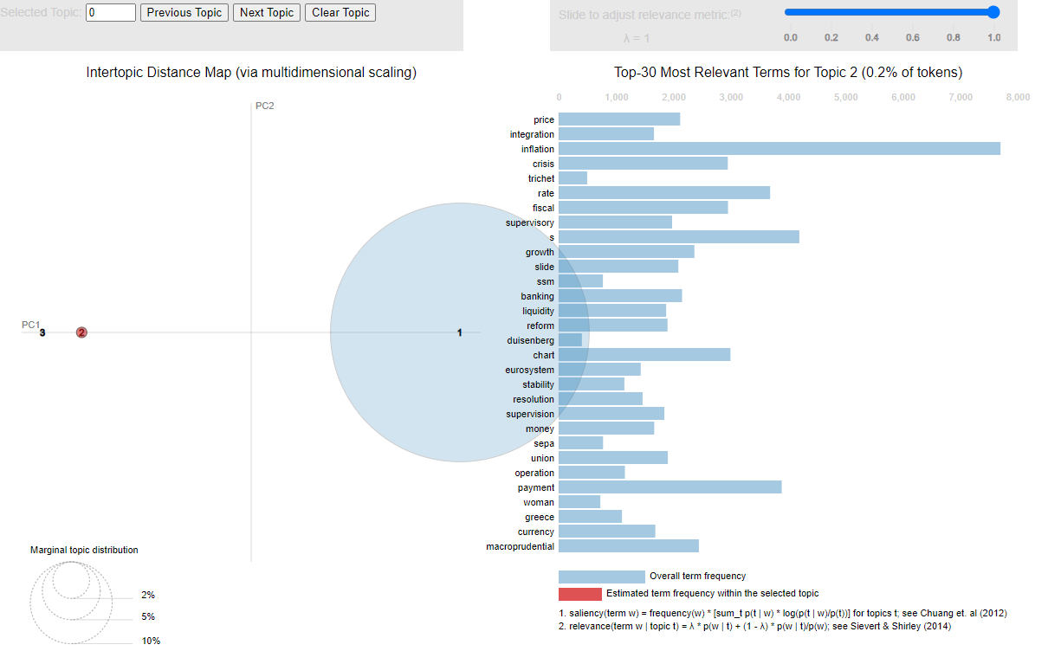
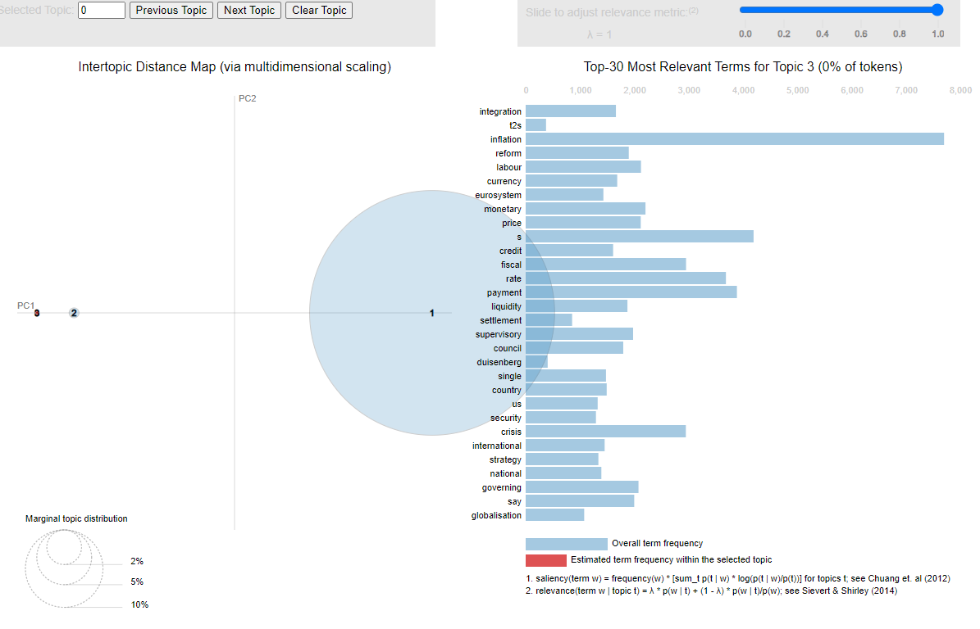
Key Topics in Speeches (Gensim LDA Visualization)
How ECB prioritizes its messaging in response to economic changes
Speeches cluster around 3–4 major themes:
Topic 1: Monetary policy, inflation, and price stability dominate discussions.
Topic 2: Digital euro and fiscal policy have emerged in recent years.
Topic 3: Broader economic growth and crisis-related topics.

Slide 9
Challenges and Complexities
Class Imbalance
The "Decrease" class was significantly underrepresented, leading to poor performance.
Semantic Complexity
Speeches often contain complex language that makes it challenging for simpler models to capture nuances.
Overfitting Risks
Deep learning models like BERT and LSTM have a high capacity, increasing the risk of overfitting on a small dataset.

Slide 10
Approaches Employed:
Handling Class Imbalance:
SMOTE: Oversampling for minority classes to balance the dataset during training.
Class Weights: Adjusted loss function to give higher weight to underrepresented classes.
Improving Feature Extraction:
BERT Fine-Tuning: Leveraged a pre-trained transformer model to extract semantic-rich features from text.
Keyphrase Extraction for LSTM: Focused on domain-specific keywords to simplify input features.
Mitigating Overfitting:
Early Stopping: Stopped training when validation loss did not improve after a set number of epochs.
Data Augmentation: Simulated additional training examples by paraphrasing existing data.

Slide 11
Methods and Models
Metrics: Accuracy, AUPRC, F1-Score (Macro and Weighted), Confusion Matrix
Train/Eval split: 80/20 Test split: 20% held-out data to evaluate the final model.
BERT, LSTM, and Logistic Regression models
Classification Task: multiclass
Labels: No Change/Increase/Decrease
Model | Architecture | Size | Challenges Addressed
BERT | Transformer | BERT | Semantic Complexity, Class Imbalance
LSTM | RNN | LSTM | Class Imbalance, Small Data Handling

Slide 12
Next Steps
Explore a multi-modal model:
Combine speech text with numerical/temporal data (e.g., historical rate changes, inflation rates) for more robust predictions.
Evaluate newer transformer models like RoBERTa or DeBERTa for better performance.
Test Sampling Techniques:
Use ADASYN or a combination of SMOTE + Cluster-Based Sampling for better oversampling.
Deploy Ensemble Models:
Combine BERT with Random Forest or XGBoost using stacking for improved performance on minority classes.

Slide 13
Q&A

